Slide 1
Java Object Oriented
Università di Modena e Reggio Emilia
Prof. Nicola Bicocchi (nicola.bicocchi@unimore.it)

Slide 2
Classes and Objects

Slide 3
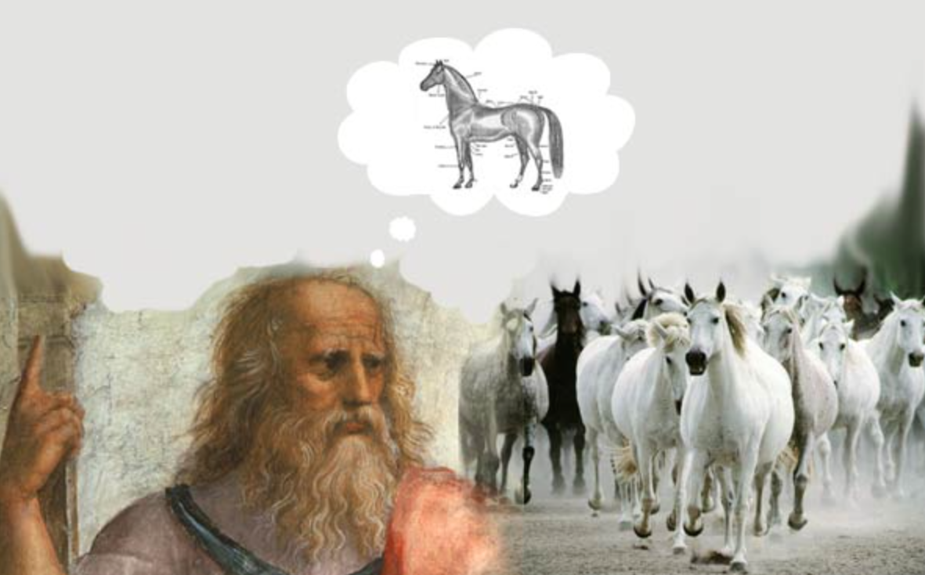
Class
Descriptor of a class of objects (Platonic idea)

Slide 4
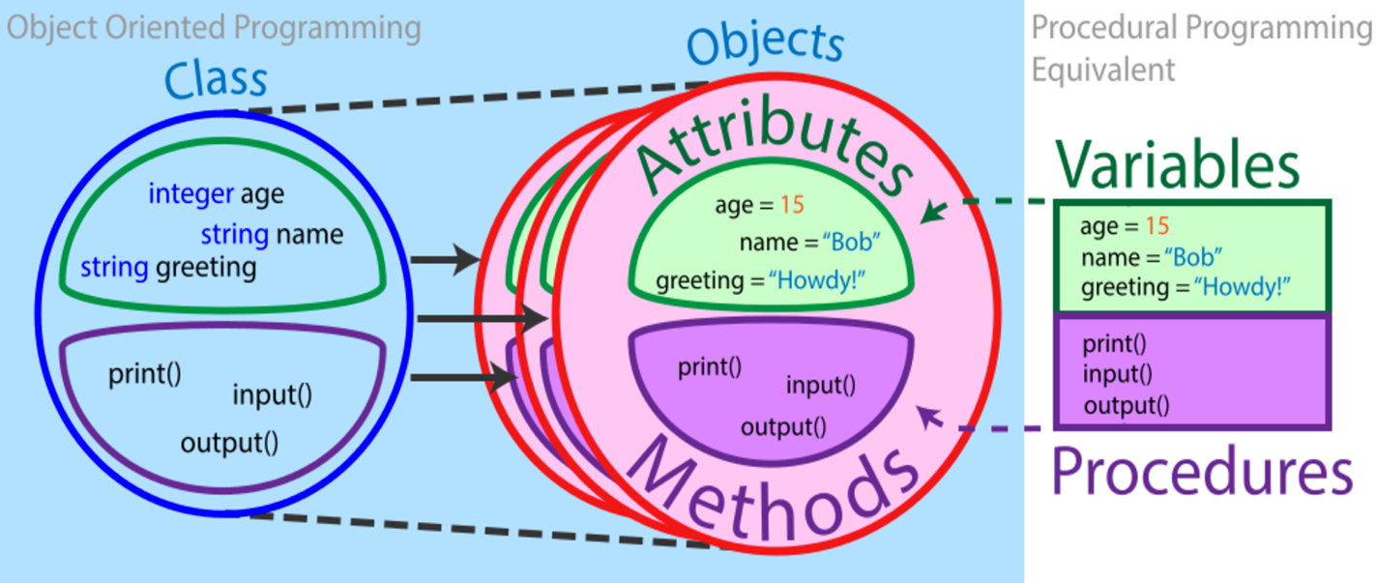
Class

Slide 5
Class Definition
public class Car {
public boolean isOn;
public String brand;
public String color;
public String getColor() {
return color;
}
public void setColor(String color) {
this.color = color;
}
public String toString() {
return "This is a car!";
}
}
Class name
Attributes
Methods

Slide 6
Information hiding
public class Car {
public String color;
public void setColor(String color) {
this.color = color;
}
}
public class App {
public static void main(String[] args) {
Car c = new Car();
c.color = “red”; /* Works but unsafe! */
}
}

Slide 7
Information hiding
public class Car {
private String color;
public void setColor(String color) {
this.color = color;
}
}
public class App {
public static void main(String[] args) {
Car c = new Car();
c.color = “red”; /* Compiler error */
c.setColor(“red”); /* Works, Safe! */
}
}

Slide 8
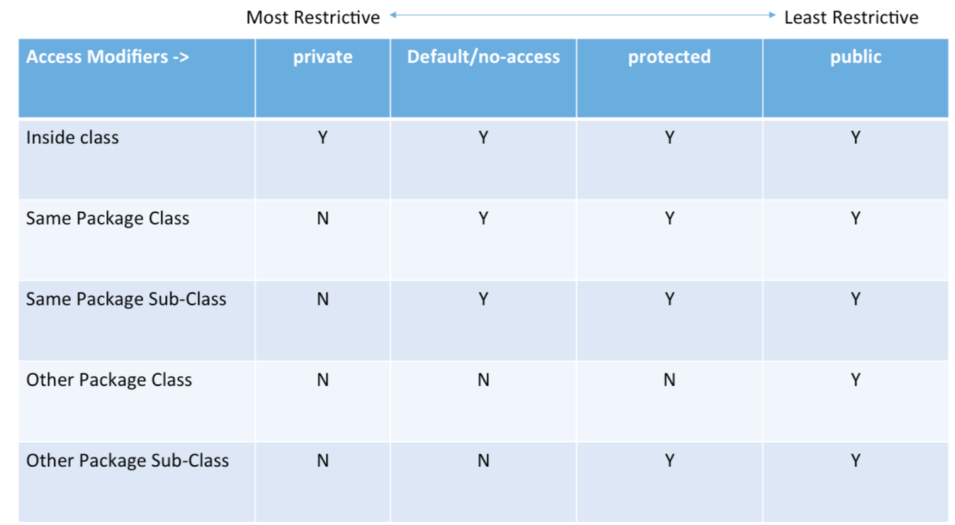
Visibility

Slide 9
Constructors
Constructor method contains operations we want to execute as soon as objects are created (attributes initialization!)
If a constructor is not defined within a class, a default one (with no parameters) is defined.
Can be automatically generated in major IDEs

Slide 10
Getters and Setters
Since attributes are usually encapsulated, methods for reading and writing them are useful. These methods are called getters and setters.
It is worth noting that, for reducing the number of errors, using the same name for method parameters and class attributes is a good practice!
Can be automatically generated in major IDEs
class Car {
String color;
...
public String getColor() {
return color;
}
public void setColor(String color) {
this.color = color;
}
}

Slide 11
toString()
It is handy to obtain a textual representation from objects.
In order to provide objects with this feature the method String toString() have to be implemented.
Can be automatically generated in major IDEs

Slide 12
toString()
public class Point { int x, y; public Point(int x, int y) { this.x = x; this.y = y; } public static void main(String[] args) { System.out.println(new Point(2, 3)); } }
# Output
org.nbicocchi.localmods.Point@3cd1a2f1
package org.nbicocchi.localmods; public class Point { int x, y; public Point(int x, int y) { this.x = x; this.y = y; } @Override public String toString() { return "Point{" + "x=" + x + ", y=" + y + '}'; } public static void main(String[] args) { System.out.println(new Point(2, 3)); } }
# Output
Point{x=2, y=3}

Slide 13
Method Overloading
Methods may have parameters
Inside a Java class there may be methods with the same name but different signatures
A signature is made by:
Method name
Ordered list of parameters types
The method whose parameters types list matches, is then executed

Slide 14
Method Overloading
public class Foo {
public int doit(int n, String s) {
return n + s.length();
}
public int doit(String s, int n) {
return n * s.length();
}
public static void main(String[] args) {
Foo f = new Foo();
System.out.println(f.doit(5, "Foo")); // 8
System.out.println(f.doit("Foo", 5)); // 15
}
}

Slide 15
Object definition
An object is identified by:
Its class, which defines its structure in terms of attributes and methods
Its state (attributes values)
Its id (unique identifier)
try: System.out.println(new int[16]);
Zero, one or more reference can point to the same object

Slide 16
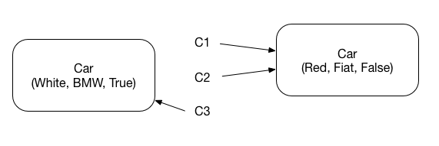
Object creation
Creation of an object is made with the keyword new
It returns a reference to the piece of memory containing the created object
Car c1 = new Car(Red, Fiat, False);
Car c2 = c1;
Car c3 = new Car(White, BMW, True)

Slide 17
The keyword new
Creates a new instance of the specified class, and allocates the necessary memory (heap)
Calls the constructor method of the class (a method without return type and with the same name of the Class)
Returns a reference to the new object created
Constructors can have parameters
String s = new String();
String s = new String(“ABC”);

Slide 18
Constructors
Constructor method contains operations we want to execute as soon as objects are created (attributes initialization!)
Overloading of constructors is often used
If a constructor is not defined within a class, a default one (with no parameters) is defined.
If a constructor is defined, the default one is disabled!

Slide 19
Constructors
public class Car {
private String color;
public void setColor(String color) {
this.color = color;
}
}
public class App {
public static void main(String[] args) {
/* Works with default constructor!
Possibly unsafe: attributes not initialized */
Car c = new Car();
}
}

Slide 20
Constructors
public class Car {
private String color;
/* Constructor */
public Car(String color) {
this.color = color;
}
public void setColor(String color) {
this.color = color;
}
}
public class App {
public static void main(String[] args) {
Car c = new Car(); /* Error! Default Constructor missing! */
Car c = new Car(“Red”); /* Works with defined constructor! */
}
}

Slide 21
Constructors
public class Car {
private String color;
public Car() {
this.color = “Red”;
}
public Car(String color) {
this.color = color;
}
public void setColor(String color) {
this.color = color;
}
}
public class App {
public static void main(String[] args) {
Car c = new Car(); /* Works with defined constructor! */
Car c = new Car(“Red”); /* Works with defined constructor! */
}
}

Slide 22
The keyword this
It can be useful in methods to distinguish between instance attributes and local variables (this represents a reference to the current object)
Accessing attributes or methods of the same object do not need using object reference
class Car{
String color;
...
public Car(String color) {
this.color = color;
}
}

Slide 23
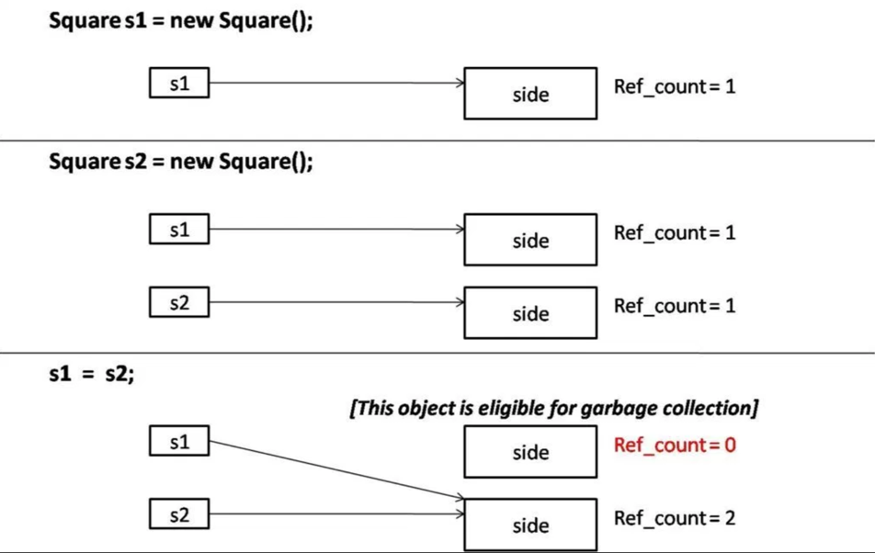
Objects destruction
It is no longer a programmer concern
Java uses Garbage Collection (an automatic way for de-allocating unreferenced objects)

Slide 24
Operations on references
Only the relational operators == and != are defined:
The equality condition tell you whether two references points to the same object in memory
The equality condition is evaluated on the values of the references and NOT on the values of the objects !
There is NO pointer arithmetic

Slide 25
Combining dotted notations
Dotted notations can be combined
System.out.println(“Hello world!”);
System is a Class in package java.lang
Out is a (static) attribute of System referencing an object of class PrintStream (representing the standard output)
println() is a method of PrintStream which prints a given string

Slide 26
Static attributes and methods

Slide 27
Static attributes and methods
Static attributes and methods are common to all instances of an object
They exist even when no object has been instantiated!
Access: ClassName.attributename|methodname
public class App {
public static void main(String[] args) {
}
}

Slide 28
Static attributes and methods
Class Car {
static final int nWheels = 4;
/* … */
}
public static void main(String[] args) {
/* access to static attributes */
int nw = Car.nWheels;
double pi = Math.PI;
…
/* access to static methods */
Double cos = Math.cos();
}

Slide 29
Wrapper Classes

Slide 30
Wrapper Classes
In an ideal OO world, there are only classes and objects
For the sake of efficiency, Java use primitive types (int, float, etc.)
Wrapper classes are object versions of the primitive types
They provide conversion operations among Strings, Objects, and primitive types

Slide 31
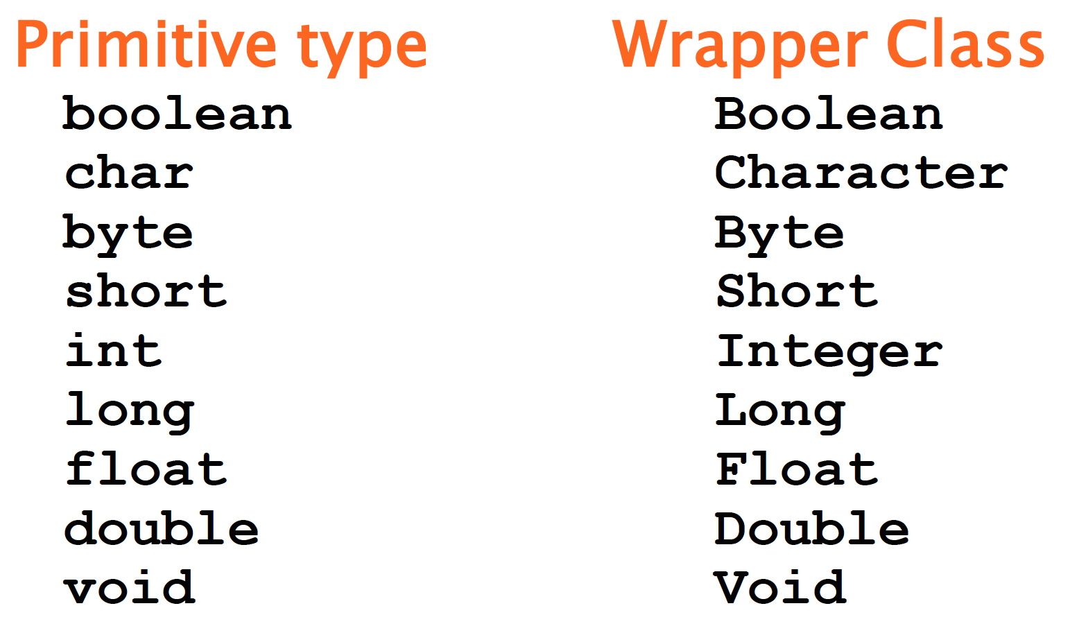
Wrapper Classes

Slide 32
Conversions
obj.toString();
Integer
Integer.valueOf(String s);
Integer.toString(int n);
int
String
Integer.parseInt(str);

Slide 33
Auto boxing/unboxing
Auto boxing is the automatic conversion that the Java compiler makes between the primitive types and their corresponding wrapper classes.
For example, converting an int to an Integer, a double to a Double, and so on.
If the conversion goes the other way around (i.e., from wrapper classes to primitive types), it is called Auto unboxing.

Slide 34
Auto boxing
public class AutoboxingExample { public static Integer myMethod(Integer n){ System.out.println(n); return n; } public static void main(String[] args) { int i = 2 + myMethod(2); } }

Slide 35
Package

Slide 36
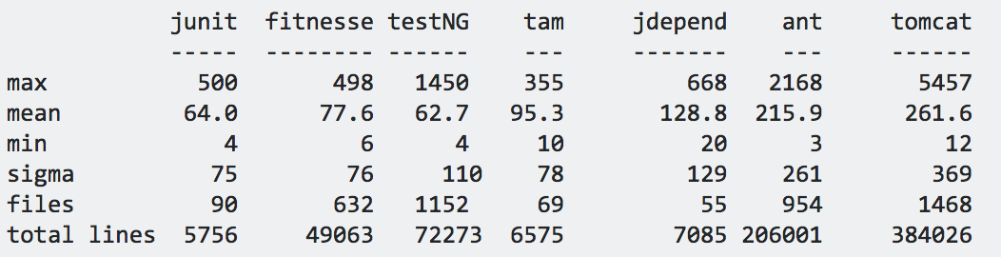
Motivation
Class is a better at modularizing code than a C function. However, it is still little (50-250 lines of code, on average)
For the sake of modularization, Java provides packages

Slide 37
Package
A package is a set of class definitions
These classes are all stored in the same directory
Each package defines a new scope (i.e., it puts additional bounds to visibility)
It’s possible to use same class names in different packages without conflicts
java.util.Date
java.sql.Date

Slide 38
Package names
A package is identified by a name with a hierarchic structure (fully qualified name)
java.lang
java.util
java.sql
Conventions for defining unique names is based on Internet naming but in reverse order (from general to specific concepts)
org.nbicocchi.basics

Slide 39
Definition and usage
Definition: Package statement at the beginning of class file
package packageName;
Usage: Import statement at the beginning of class file
import packageName.className;

Slide 40
Access to a class in a package
Refer to fully qualified names
int i = mypackage.Console.readInt()
If two packages contain a class with the same name, they cannot be both imported. If you need both classes you have to use one of them with its fully-qualified name:
import java.sql.Date; Date d1 = new Date(); // java.sql.Date java.util.Date d2 = new java.util.Date();

Slide 41
Package and scope
Scope rules also apply to packages
The interface of a package is the set of public classes contained in the package
Hints
Consider a package as an entity of modularization
Minimize the number of classes, attributes, methods (of the package) visible from the outside

Slide 42
Inheritance

Slide 43

Motivation
They all move, have a shape, shields, and weapons. Can they share the same code?

Slide 44
Motivation
Frequently, a class is merely a modification of another class. Inheritance allows minimal repetition of the same code
A new design created by changing an existing design. (The new design consists of only the changes)
Localization of code
Fixing a bug in the base class automatically fixes it in the subclasses
Adding functionalities to the base class automatically adds them to the subclasses
Reduced chances of different (and inconsistent) implementations of the same operation

Slide 45
Inheritance
A class can be a sub-type of another class
The inheriting class contains all the attributes and methods of the class it inherited from
The inheriting class can define additional attributes and methods
The inheriting class can override the definition of existing methods by providing its own implementation
The code of the inheriting class consists only of the changes and additions to the base class

Slide 46
Example I (extension)
Class Car {
boolean isOn;
String licensePlate;
void turnOn() {…}
void turnOff() {…}
}
Class SDCar extends Car {
boolean isSelfDriving;
void turnSDOn() {…}
void turnSDOff() {…}
}
SDCar c = new SDCar();
c.turnOn(); // OK!
c.turnSDOn(); // OK!
*SD = Self Driving

Slide 47
Example II (override)
Class Car {
boolean isOn;
String licensePlate;
void turnOn() {…}
void turnOff() {…}
}
Class SDCar extends Car {
boolean isSelfDriving;
/* method override */
void turnOn() {
turnSDOff();
/* … */
}
/* method override */
void turnOff() {
turnSDOff();
/* … */
}
void turnSDOn() {…}
void turnSDOff() {…}
}

Slide 48
Example III (override)
Class Car {
boolean isOn;
string licensePlate;
void turnOn() {…}
void turnOff() {…}
}
Class SDCar extends Car {
boolean isSelfDriving;
/* override */
void turnOn() {
turnSDOff();
super.turnOn();
}
void turnOff() {
turnSDOff();
super.turnOff();
}
void turnSDOn() {…}
void turnSDOff() {…}
}

Slide 49
Class SDCar
Inherits
attributes (isOn, licencePlate)
methods (turnOn, turnOff)
Adds
attributes (isSelfDriving)
methods (turnSDOn, turnSDOff)
Modifies (overrides)
methods (turnOn, turnOff)
Class SDCar extends Car {
boolean isSelfDriving;
/* override */
void turnOn() {
turnSDOff();
super.turnOn();
}
void turnOff() {
turnSDOff();
super.turnOff();
}
void turnSDOn() {…}
void turnSDOff() {…}
}

Slide 50
this and super
this is a reference to the current object
super is a reference to the parent class

Slide 51
Terminology
Class one above
Parent class
Class one below
Child class
Class one or more above
Superclass, Ancestor class, Base class
Class one or more below
Subclass, Descendent class

Slide 52
Visibility and Inheritance

Slide 53
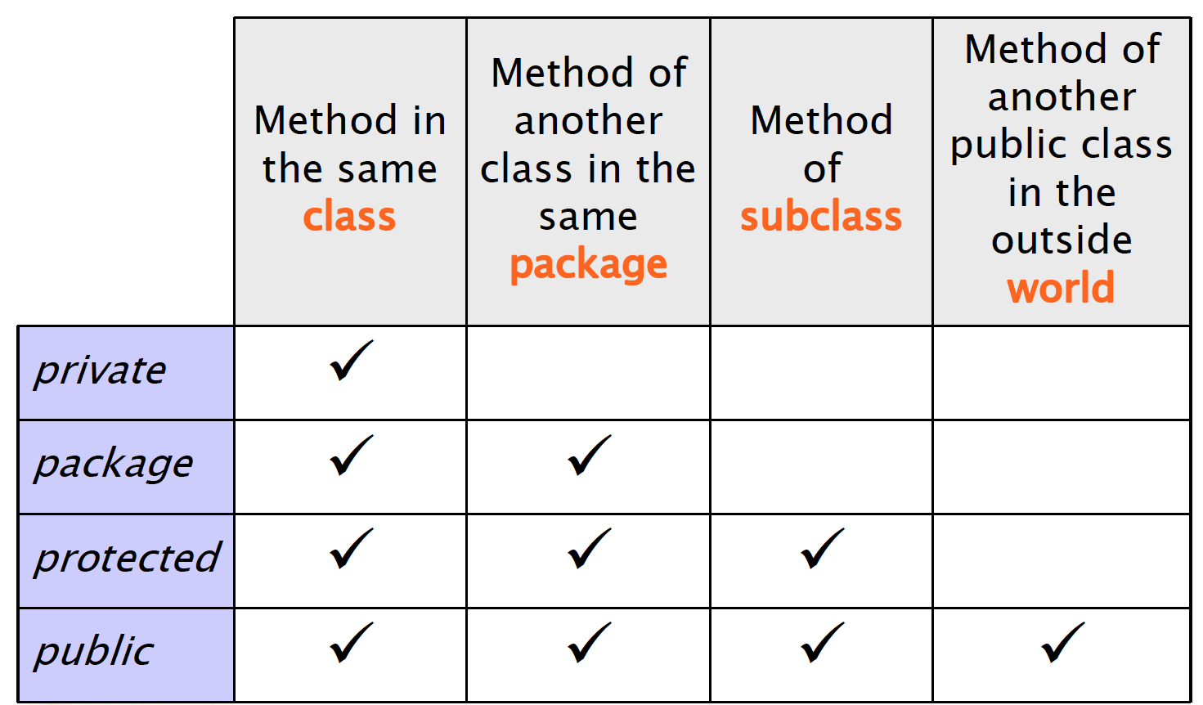
Recap

Slide 54
Visibility
Class Car {
private boolean isOn;
private string licensePlate;
public void turnOn() {…}
public void turnOff() {…}
}
Class SDCar extends Car {
void print() {
/* Do not work! Not visible! */
System.out.println(licencePlate);
}
}

Slide 55
Visibility
Class Car {
boolean isOn;
string licensePlate;
public void turnOn() {…}
public void turnOff() {…}
}
Class SDCar extends Car {
void print() {
/*
* Works if Car and SDCar
* share the same package
*/
System.out.println(licencePlate);
}
}

Slide 56
Visibility
Class Car {
protected boolean isOn;
protected string licensePlate;
public void turnOn() {…}
public void turnOff() {…}
}
Class SDCar extends Car {
void print() {
/* Works anyway! */
System.out.println(licencePlate);
}
}

Slide 57
Inheritance and constructors

Slide 58
Construction of child objects
Since each subclass “contains” an instance of the parent class, the latter must be initialized
Java compiler automatically calls the default constructor (no params!) of the parent class
The call is inserted as the first statement of each child constructor. If parent class disabled default constructor (by defining others) parent constructor must be called explicitly!

Slide 59
super()
this is a reference to the current object
super is a reference to the parent class
super() calls the default constructor of parent class
super(params) calls other constructors of parent class
Must be the first statement in child constructors

Slide 60
Example
class Car {
boolean isOn;
String licensePlate;
/* Default constructor enabled! */
}
class SDCar extends Car {
boolean isSelfDriving;
/* Default constructor enabled! */
} // Works!

Slide 61
Example
class Car {
boolean isOn;
String licensePlate;
/* Default constructor enabled! */
}
class SDCar extends Car {
boolean isSelfDriving;
/* Default constructor disabled! */
public SDCar() {
/* automatic call to parent default constructor here! */
}
} // Works!

Slide 62
Example
class Car {
boolean isOn;
String licensePlate;
/* Default constructor disabled! */
public Car(boolean isOn, String licensePlate) {
this.isOn = isOn;
this.licencePlate = licensePlate;
}
}
class SDCar extends Car {
boolean isSelfDriving;
/* Default constructor disabled! */
public SDCar() {
/* automatic call to parent default constructor here! */
}
} // Not working!

Slide 63
Example
class Car {
boolean isOn;
String licensePlate;
/* Default constructor disabled! */
public Car(boolean isOn, String licensePlate) {
this.isOn = isOn;
this.licencePlate = licensePlate;
}
}
class SDCar extends Car {
boolean isSelfDriving;
/* Default constructor disabled! */
public SDCar(boolean isOn, String licensePlate, boolean isSelfDriving) {
super(isOn, licencePlate);
this.isSelfDriving = isSelfDriving;
}
} // Works!

Slide 64
Construction of child objects
Execution of constructors proceeds top-down along the inheritance hierarchy
In this way, when a method of the child class is executed (constructor included), the super-class is completely initialized already
class Car{
Car() {
super();
System.out.println(“Car”);
}
}
class SDCar extends Car {
SDCar() {
super();
System.out.println(“SDCar”);
}
}
// Which output?
SDCar c = new SDCar();

Slide 65
Dynamic binding and polymorphism
When using collections of objects belonging to a hierarchy of classes, methods actually called are known only at runtime.
The same call (methods with the same signature) might have different results (polymorphism) depending on the actual class of the object.
* https://en.wikipedia.org/wiki/Late_binding
Car[] garage = new Car[4];
garage[0] = new Car();
garage[1] = new SDCar();
garage[2] = new SDCar();
garage[3] = new Car();
for(Car c : garage) {
c.turnOn();
}
/*
Which method is actually called
is not knowable at compile time!
*/

Slide 66
Object

Slide 67
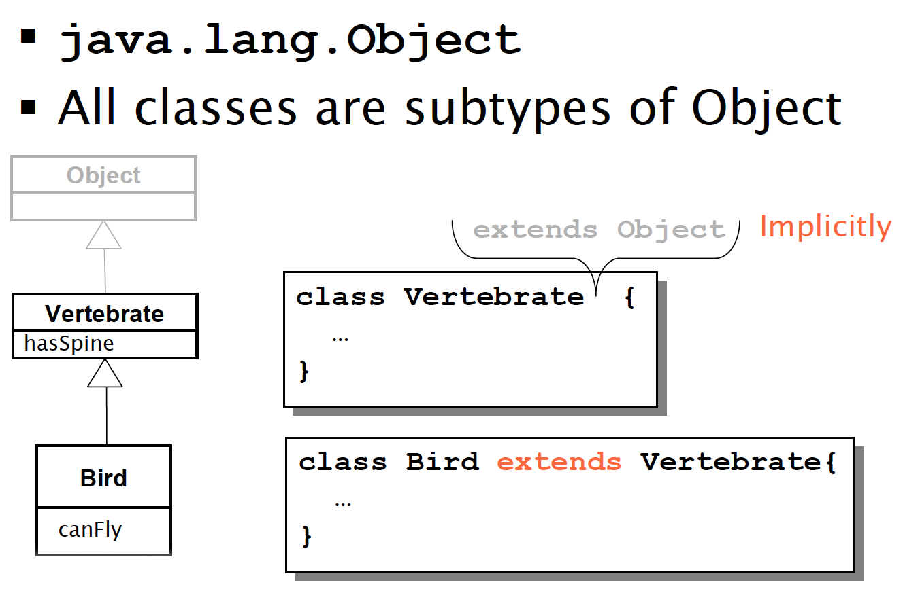
Java.lang.Object

Slide 68
Java.lang.Object
All objects can be seen as Object instances
Object defines basic services, which are useful for all classes. They are often overridden in sub-classes. For example:
toString(): returns a string representation
equals(Object o): tests equality
clone(): returns a shallow copy of the object

Slide 69
toString()
class Car{
String licencePlate;
public String toString(){
return “[Car] ” + licencePlate;
}
}
Car c = new Car();
// println(Object) call
System.out.println(c);
// println(String) call
System.out.println(c.toString());

Slide 70
equals(Object o)
public class Car {
boolean isOn;
String licencePlate;
public Car(boolean isOn, String licencePlate) {
this.isOn = isOn;
this.licencePlate = licencePlate;
}
public static void main(String[] args) {
Car c1 = new Car(true, "AA334GG");
Car c2 = new Car(true, "AA334GG");
System.out.println(c1.equals(c2)); // false!
}
}

Slide 71
equals(Object o)
public class Car {
boolean isOn;
String licencePlate;
public Car(boolean isOn, String licencePlate) {
this.isOn = isOn;
this.licencePlate = licencePlate;
}
/* the equals() methods must be overridden */
public boolean equals(Object obj) {
Car other = (Car) obj;
if (isOn != other.isOn)
return false;
if (licencePlate != other.licencePlate)
return false;
return true;
}
}

Slide 72
Casting

Slide 73
Types
Java is a strictly typed language. Each variable has a type!
float f;
f = 4.7; //OK!
f = “hello!”; //!OK
Car c;
c = new Car(); //OK!
c = new String(); //!OK

Slide 74
Upcasting and Downcasting
class Car {};
class SDCar extends Car {};
Car c1 = new Car(); // OK!
SDcar c2 = new SDCar (); // OK!
But also…
Car c3 = new SDcar();

Slide 75
Upcasting and Downcasting
Car c3 = new SDcar();
Specialization defines a sub-typing relationship (is a ).
All SDCar(s) are Car(s). Not all Car(s) are SDCar(s).
Upcasting and downcasting refer to the possibility of changing the reference type of a given object. Upcasting consists in using more general references, while downcasting more specific references.
Upcast
Downcast
SDCar(s)
Car(s)

Slide 76
Upcasting and Downcasting
More general
Reference (Car)
More specific
Reference (SDCar)
Actual object methods (SDCar)

Slide 77
Upcasting
class Car {};
class SDCar extends Car {};
Car c = new SDCar();
Assignment from a more specific type to a more general type
Note well: reference type and object type are separate concepts. Object referenced by ‘c’ continues to be of SDCar type! Only the interface changes!

Slide 78
Upcasting
It is dependable
It is always true that an SDCar is a Car too
It is automatic
Car c = new SDCar();

Slide 79
Example
Class Car {
boolean isOn;
string licensePlate;
void turnOn() {…}
void turnOff() {…}
}
Class SDCar extends Car {
boolean isSelfDriving;
void turnSDOn() {…}
void turnSDOff() {…}
}
SDCar c1 = new SDCar();
c1.turnSDOn() // OK!
Car c2 = c1; // Upcast
c2.turnSDOn() // Compile time error!
(Car interface does not provide turnSDOn() call)

Slide 80
Downcasting
Assignment from a more general type (super-type) to a more specific type (sub-type)
Reference type and object type do not change
MUST be explicit
It’s a risky operation, no automatic conversion provided by the compiler (it’s up to you!)

Slide 81
Example
Class Car {
boolean isOn;
string licensePlate;
void turnOn() {…}
void turnOff() {…}
}
Class SDCar extends Car {
boolean isSelfDriving;
void turnSDOn() {…}
void turnSDOff() {…}
}
Car c1 = new SDCar();
c1.turnSDOn() // Compile time error!
SDCar c2 = (SDcar)c1; // Downcast
c2.turnSDOn() // Accidentally OK! The object referenced by c1 was actually of class SDCar

Slide 82
Example
Class Car {
boolean isOn;
string licensePlate;
void turnOn() {…}
void turnOff() {…}
}
Class SDCar extends Car {
boolean isSelfDriving;
void turnSDOn() {…}
void turnSDOff() {…}
}
Car c1 = new Car();
c1.turnSDOn() // Compile time error!
SDCar c2 = (SDcar)c1; // Downcast
c2.turnSDOn() // Run time error!

Slide 83
Runtime is evil
Compilers aid developers in writing working code. Runtime errors cannot be identified by compilers. Developers must be careful!
Use the instanceof operator
Car c = new SDCar();
if (c instanceof SDCar){
SDCar sdc = (SDCar) c;
sdc.turnSDOn();
}

Slide 84
Upcast to object
Each class is either directly or indirectly a subclass of Object
It is always possible to upcast any instance to Object type (see Collection)
AnyClass any = new AnyClass();
Object obj = (Object)any;

Slide 85
Abstract Classes and Interfaces

Slide 86
Abstract methods
You can declare an object without implementing it:
Person p;
Similarly, you can declare a method without implementing it (i.e., the body of the method is missing):
public abstract void draw(int size);
A method that has been declared but not defined is an abstract method
86

Slide 87
Abstract classes
Any class containing one or more abstract methods is an abstract class
An abstract class is incomplete in the sense it has missing method bodies
You must declare the class with the keyword abstract:
abstract class MyClass {...}
You cannot instantiate (create a new instance of) an abstract class

Slide 88
Abstract classes
You can extend (subclass) an abstract class
If the subclass defines all the inherited abstract methods, it is concrete and can be instantiated
If the subclass does not define all the inherited abstract methods, it must be abstract too
You can declare a class to be abstract even if it does not contain any abstract methods
This just prevents the class from being instantiated

Slide 89
Why use abstract classes?
Suppose you wanted to create a class Shape, with subclasses Oval, Rectangle, Triangle, Hexagon, etc.
Each subclass has a method draw() for representing its shape on a 2D graphic panel

Slide 90
A problem
class Shape { ... }
class Star extends Shape { void draw() { ... } ... }
class Circle extends Shape { void draw() { ... } ... }
Shape s;
s = new Shape(); // Legal, but unwanted
s.draw(); // Illegal, Shape does not have draw()
s = new Star(); // Legal, because a Star is a Shape
s.draw(); // Illegal, Shape does not have draw()

Slide 91
Same problem, another view
Shape[] shapes = new Shape[16];
shapes[0] = new Circle();
shapes[1] = new Star();
…
for (Shape s : shapes) {
s.draw(); // Illegal, Shape does not have draw()
}

Slide 92
A solution
abstract class Shape { abstract void draw(); }
class Star extends Shape { void draw() { ... } ... }
class Circle extends Shape { void draw() { ... } ... }
Shape s;
s = new Shape(); // Illegal, Shape is abstract
s = new Star(); // Legal, because a Star is a Shape
s.draw(); // Legal, Shape does have draw()

Slide 93
Another problem
Let’s suppose that all shapes must have two capabilities:
Drawing their own shape [draw() method]
Setting a unique ID [setID() method]
93

Slide 94
A solution
We can keep the Shape class abstract while providing a common implementation of the setID() method.
Benefits
Shape cannot be instantiated
Shape subclasses can redefine draw()
Drawbacks
We partially loose the possibility to define abstract concepts such as Shape. Now Shape contains code!
abstract class Shape {
void setID() { . . . }; abstract void draw(); }
class Star extends Shape { void draw() { ... } ... }
class Circle extends Shape { void draw() { ... } ... }
94

Slide 95
A better solution
We can use a Shape Interface.
Interfaces are special classes for declaring methods without supplying implementations
All their methods are implicitly public and abstract
Interfaces cannot be instantiated because they do not contain actual code
When a class implements an interface, it promises to define all the methods declared in the interface
interface Shape() {
public abstract void setID(); public abstract void draw();
}
abstract class AbstractShape implements Shape {
void setID() { . . . }; abstract void draw(); }
class Star extends AbstractShape { void draw() { ... } ... }
class Circle extends AbstractShape { void draw() { ... } ... }
Level of abstraction
95

Slide 96
Specialization and partial implementation
Interfaces can be specialized
Specializing an interface means adding new methods in derived interfaces. Overriding methods does not make sense in interfaces because code is absent.
Interfaces can be partially implemented
Partial implementations of interfaces can be found in abstract classes. The unimplemented methods must be marked as abstract.

Slide 97
Multiple inheritance
In Java, a class can only extend one class, but can implement multiple interfaces
This lets the class fill multiple roles (i.e., multiple set of methods)
In graphical interfaces (GUIs), it is common to have one class implementing several listeners (i.e., interfaces)
class Application extends JFrame implements ActionListener, KeyListener { ... }

Slide 98
Multiple inheritance
public class GroudVehicle {
activateWheels() {…}
…
}
public class WaterVehicle {
activateWaterFans() {…}
…
}
// Not allowed in Java!! Only one class can be extended!
public class Anphibian extends GroudVehicle, WaterVehicle {
…
}
98

Slide 99
Multiple inheritance
public interface GroudVehicle {
activateWheels();
…
}
public interface WaterVehicle {
activateWaterFans();
…
}
public class Anphibian implements GroudVehicle, WaterVehicle {
activateWheels() {…}
activateWaterFans() {…}
…
}
99

Slide 100
Interfaces and instanceof
instanceof is a keyword that tells you whether a variable “is a” member of a class or interface
Membership of a class or interfaces can be translated with “has its methods implemented”
class Dog extends Animal implements Pet {...}
Dog lessie = new Dog();
lessie instanceof Dog //OK!
lessie instanceof Animal //OK!
lessie instanceof Pet //OK!

Slide 101
Modelling Object Oriented Software

Slide 102
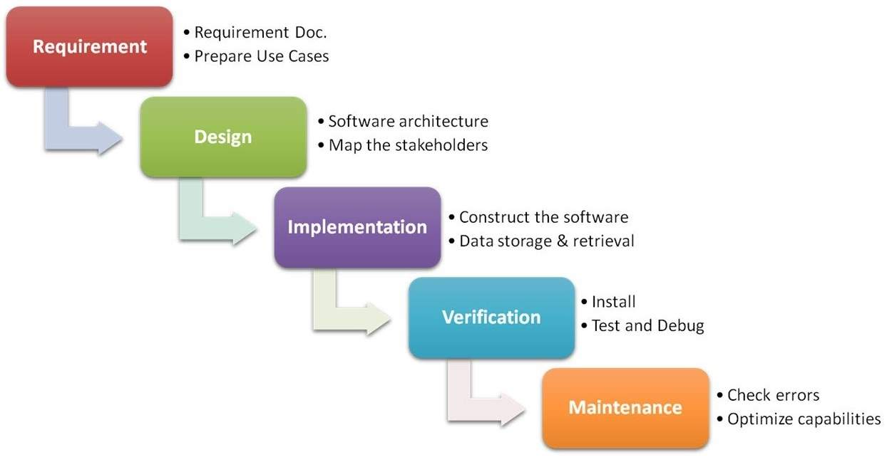
Waterfall model

Slide 103
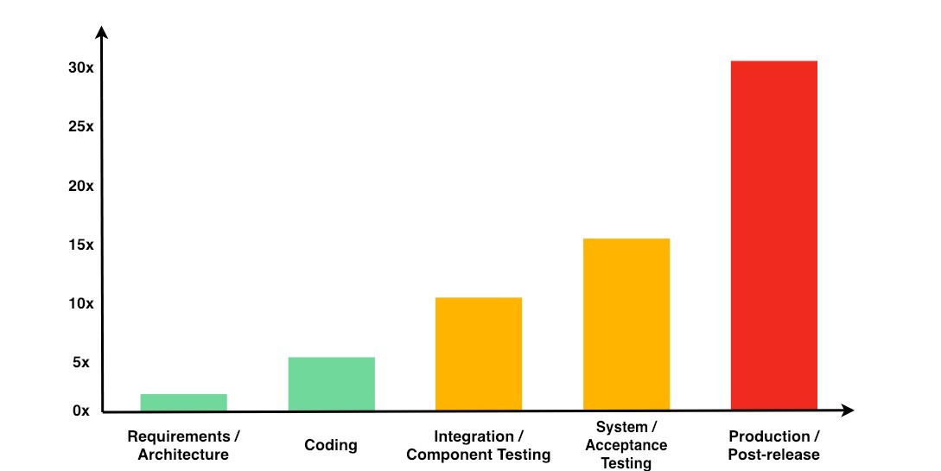
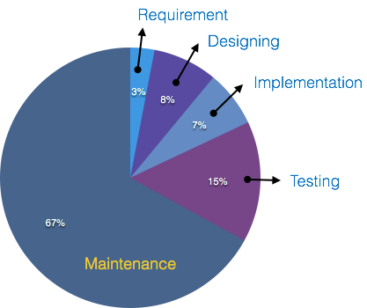
Software life-cycle costs

Slide 104
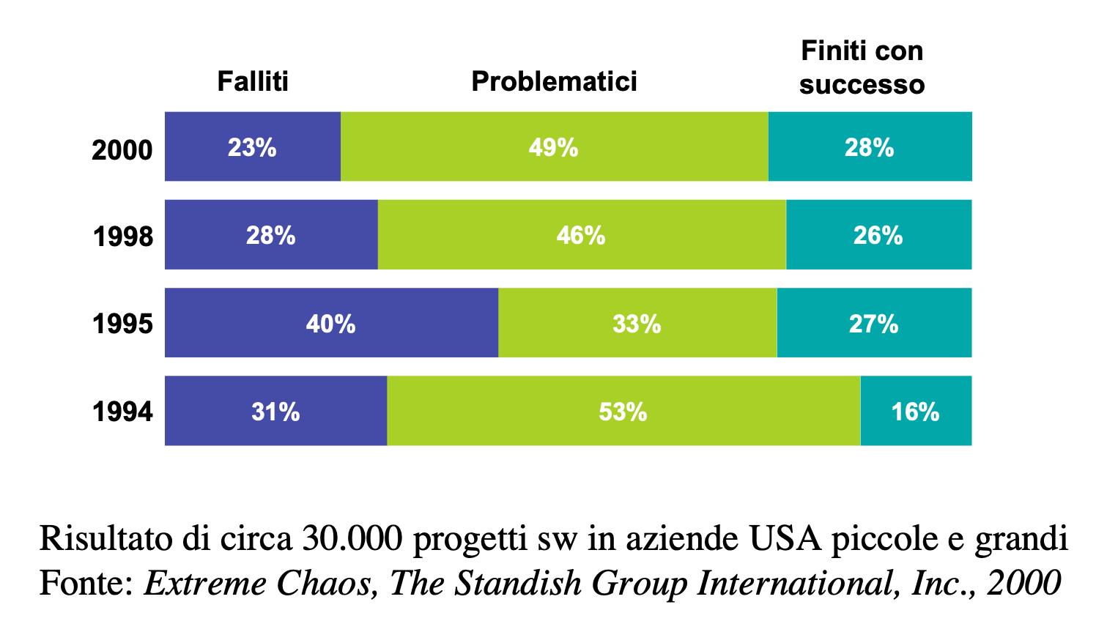
Failure rates of software projects

Slide 105
Root causes of failures
Lack of user participation
Changing requirements
Badly defined system requirements
Unrealistic or unarticulated project goals
Lack of Stakeholder involvement
Unmanaged risks
Poor communication among customers, developers, and users
Use of immature technology
Inability to handle the project’s complexity
Sloppy development practices
Poor project management
Poor reporting of the project’s status
Inaccurate estimates of needed resources
Commercial pressures

Slide 106
So what?
Iterative development models
RUP, SCRUM, Extreme Programming
Modelling tools and languages
UML

Slide 107
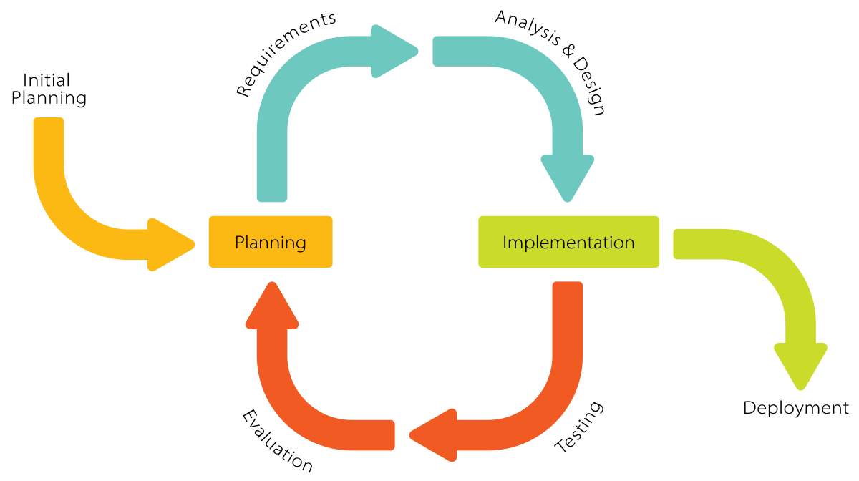
Iterative development models

Slide 108
Modelling tools and languages
UML stands for Unified Modeling Language
Language: express idea, not a methodology
Modeling: Describing a software system at a high level of abstraction
Unified: UML has become a world standard

Slide 109
UML
It is a industry-standard graphical language for specifying, visualizing, constructing, and documenting the artifacts of software systems
UML uses mostly graphical notations to express the OO analysis and design of software projects.
Simplifies the complex process of software design

Slide 110
UML benefits
Use graphical notation: more clearly than natural language (imprecise) and code (too detailed).
Help acquire an overall view of a system.
UML is not dependent on any one language or technology.
UML moves us from fragmentation to standardization.

Slide 111
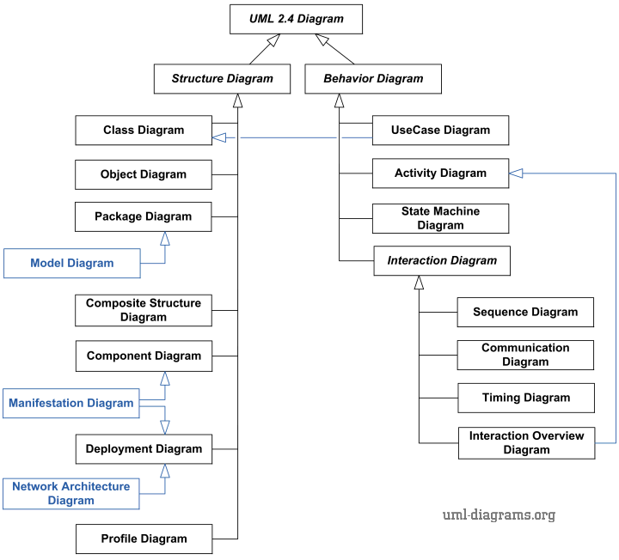
UML diagrams

Slide 112
Class diagram
A class diagram depicts classes and their interrelationships
Used for describing the internal structure of a software system
Provide a conceptual model of the system in terms of entities and their relationships
Detailed class diagrams are used for developers

Slide 113
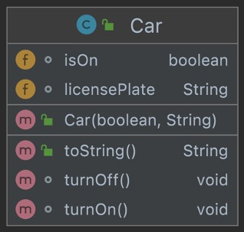
Class
package org.nbicocchi.oopinheritance.car;
public class Car {
boolean isOn;
String licensePlate;
public Car(boolean isOn, String licensePlate) {
this.isOn = isOn;
this.licensePlate = licensePlate;
}
void turnOn() {
isOn = true;
}
void turnOff() {
isOn = false;
}
@Override
public String toString() { … }
}

Slide 114
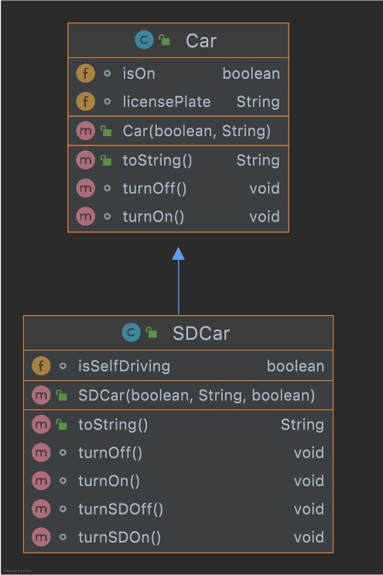
Hierachy
public class SDCar extends Car {
boolean isSelfDriving;
public SDCar(boolean isOn, String licensePlate, boolean isSelfDriving) {
super(isOn, licensePlate);
this.isSelfDriving = isSelfDriving;
}
@Override
void turnOn() {
isSelfDriving = false;
super.turnOn();
}
@Override
void turnOff() {
isSelfDriving = false;
super.turnOff();
}
void turnSDOn() {
isSelfDriving = true;
}
void turnSDOff() {
isSelfDriving = false;
}
@Override
public String toString() {…}
}

Slide 115
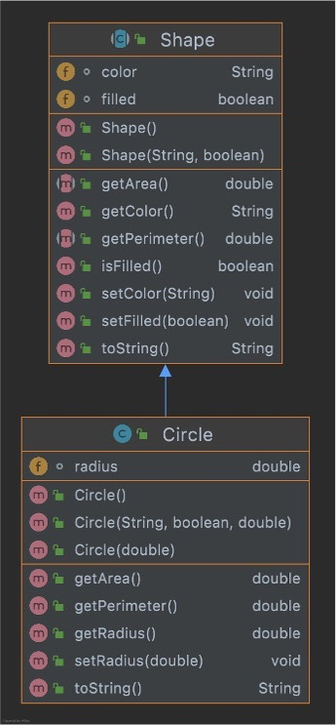
Abstract class
public abstract class Shape {
String color;
boolean filled;
public Shape() {
this.color = "Black";
this.filled = false;
}
public Shape(String color, boolean filled) {
this.color = color;
this.filled = filled;
}
. . .
public abstract double getArea();
public abstract double getPerimeter();
}

Slide 116
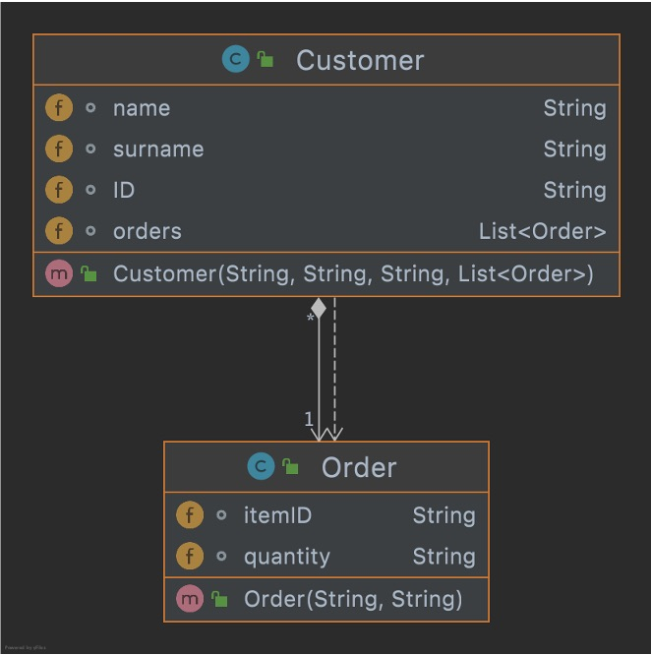
Association
public class Customer {
String name;
String surname;
String ID;
List<Order> orders;
public Customer(String name, String surname, String ID, List<Order> orders) {
this.name = name;
this.surname = surname;
this.ID = ID;
this.orders = orders;
}
}
public class Order {
String itemID;
String quantity;
public Order(String itemID, String quantity) {
this.itemID = itemID;
this.quantity = quantity;
}
}

Slide 117
Association
public class Customer {
String name;
String surname;
String ID;
public Customer(String name, String surname, String ID) {
this.name = name;
this.surname = surname;
this.ID = ID;
}
}
public class Order {
String itemID;
String quantity;
Customer customer;
public Order(String itemID, String quantity, Customer customer) {
this.itemID = itemID;
this.quantity = quantity;
this.customer = customer;
}
}

Slide 118
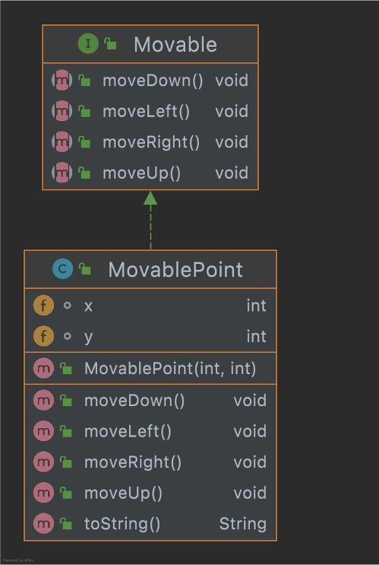
Interfaces
public interface Movable { void moveUp(); void moveDown(); void moveLeft(); void moveRight(); }
public class MovablePoint implements Movable {
int x;
int y;
public MovablePoint(int x, int y) {
this.x = x;
this.y = y;
}
@Override
public void moveUp() {
y += 1;
}
@Override
public void moveDown() {
y -= 1;
}
@Override
public void moveLeft() {
x -= 1;
}
@Override
public void moveRight() {
x += 1;
}
}

Slide 119
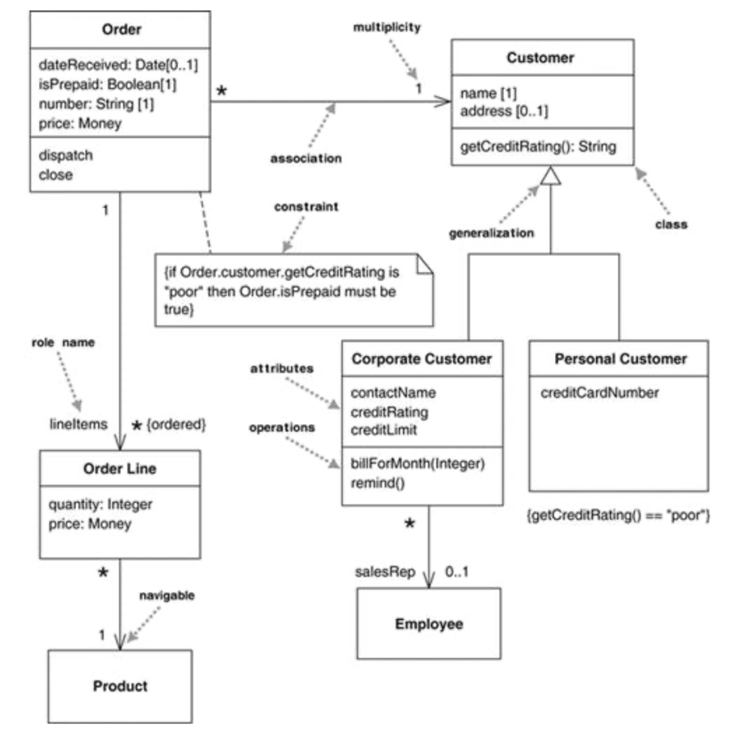
A complete example

Slide 120
Complexity has nothing to do with intelligence, simplicity does.
— Larry Bossidy
Ex CEO Honeywell
Perfection is achieved, not when there is nothing more to add, but when there is nothing left to take away.
— Antoine de Saint Exupery
Scrittore, aviatore francese

